Slide 1

A Project Presentation on
College Predictor
Under The Guidance of
Mrs. Pooja Bhondve
Presented by
Saurabh Mohite
Saurabh Bankar
Rohan Darandale
Dhananjay Sonune
Second Year, Department of Computer engineering
DYPCOE Akurdi,Pune Project Presentation
1

Slide 2
Presentation Outline
Problem Statement
Objectives
Methodology
Software and Hardware Requirements
Implementation
Results
References
DYPCOE, Akurdi Project Presentation
12 June 2023
2

Slide 3
1.Problem Statement
There are more than 400 engineering colleges in Maharashtra, for which admission is governed by DTE (Directorate of Technical Education).
It's very difficult for the students to and out suitable colleges for them based on their MHCET Score, MHCET Rank, Category, etc. Various colleges provide degree in engineering in various branches (IT, Computer, Mechanical, etc.)
It is very tedious job for a student to understand about the suitable colleges which provides preferred branch and to analyses it's last three years cut offs in order to predict whether that he can get one of those colleges in CAP.
Most of the students make mistakes in their preference list due to lack of knowledge, improper and incorrect analysis of colleges.
Hence those students regret after what they get the college after allotment. Our project will solve the issue of the student community by using a technology.
We are designing a web application College Predictor for predicting the college through an algorithm for students who aspires for taking admission in engineering through CAP
Project Presentation
3

Slide 4
2. Objectives
Primary Goal :
To develop a website which predicts the best colleges based on respective marks/percentiles and guide the student throughout the admission process in Maharashtra(MHT – CET)
To bring ease in admission process for students.
Project Presentation
4

Slide 5
3.1 Methodology
1.Frontend:
HTML (Hypertext Markup Language):
The Hypertext Markup Language or HTML is the standard markup language for documents designed to be displayed in a web browser.HTML elements are the building blocks of HTML page.
Web browsers receive HTML documents from a web server or from local storage and render the documents into multimedia web pages.
HTML describes the structure of a web page semantically and originally included cues for its appearance.
CSS (Cascading Style Sheets):
Cascading Style Sheets (CSS) is a style sheet language used for describing the presentation of a document written in a markup language such as HTML. CSS is a cornerstone technology of the World Wide Web, alongside HTML and JavaScript.
CSS is designed to enable the separation of content and presentation, including layout, colors, and fonts. CSS has a simple syntax and uses a number of English keywords to specify the names of various style properties.
Project Presentation
5

Slide 6
3.2 Methodology
2.Architectural flow of Project:
Project Presentation
6

Slide 7
3.3 Methodology
3.Backend Logic:
Web Server: The web server is responsible for handling incoming requests from users and delivering the appropriate responses. The server interacts with the database to fetch and store data.
Student provides their MHT_CET exam marks and category through the website.
The backend is built using Node.js and Express.js, receives this information.
The backend then queries the MongoDB database to find colleges that have a cutoff lower than the marks entered by the student.
The backend also checks if the student's category matches the category specified in the database.
The database contains information such as college names and percentiles according to cutoff.
Based on the query results, the backend compiles a list of colleges that meet the criteria.
The backend sends this list of colleges back to the website, where it can be displayed to the student.
To summarize, the backend receives the student's marks and category, searches the database for colleges that have a lower cutoff and match the category, and returns a list of suitable colleges to the website.
Project Presentation
7

Slide 8
3.4 Methodology
4.Database:
Database responsible for storing and managing the website's data, including college cutoff list, login and signup details. It allows efficient retrieval, storage, and querying of data. We have used MongoDB database.
The database stores information about colleges, including their names and percentiles according to cutoffs and category.
When a student provides their marks and category, the backend queries the database to find colleges that match the criteria.
The backend filters the colleges based on two conditions:
First, it checks if the cutoff percentile of the college is lower than the marks entered by the student.
Second, it verifies if the college's category matches the category specified by the student.
Once the filtering is complete, the backend compiles a list of suitable colleges.
The backend sends this list back to the website, where it can be displayed to the student.
In summary, the database stores college information, and the backend uses this information to filter and retrieve colleges that have lower cutoffs and match the student's category. The filtered results are then sent back to the website for display to the student.
Project Presentation
8

Slide 9
4. Software Hardware Requirements
Software Requirements :-
Visual Studio Code -Text Editor
Supported Operating System: Windows 11
Supported Databases: MongoDB
Languages: HTML, CSS, JavaScript.
JavaScript extensions: NodeJS, express.
MongoDB Compass.
Hardware Requirements :-
Dual-Core 2 GHZ or higher
4 GB RAM
1 GB free disk space
Other Requirements :-.
The college recommendation system requires data from the latest CAP round containing percentage, seat-type, college name, college location and course name, etc. for college listing, this data is extracted from pdf provided by the mahacet.org for every college and is stored into a database.
Project Presentation
9

Slide 10
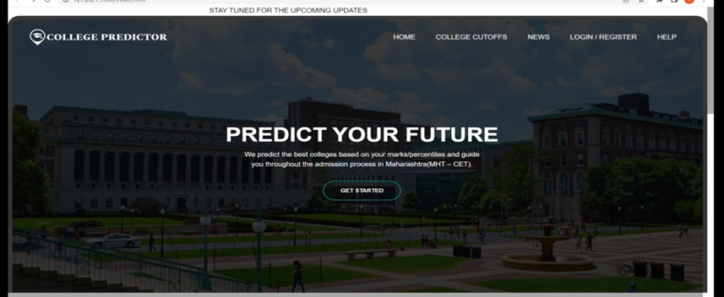
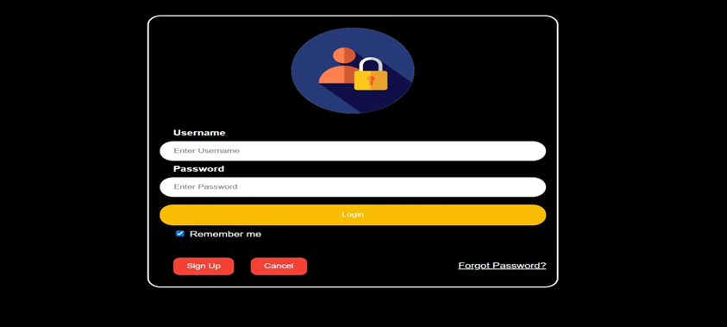
5.1 Implementation 1.GUI of Webpages:
2.Login Page:
In this page two field are there namely email(username) and password after filling this field you will redirect on the percentile page.
Authentication is done by using MongoDB database.
1.Home Page:
It contains option for Login/Signup, Top College`s Information, etc.
After clicking on GET STARTED button user will redirect on page which shows field to enter percentiles and category of student if user is logged in else it will redirect to Login Page.
Project Presentation
10

Slide 11
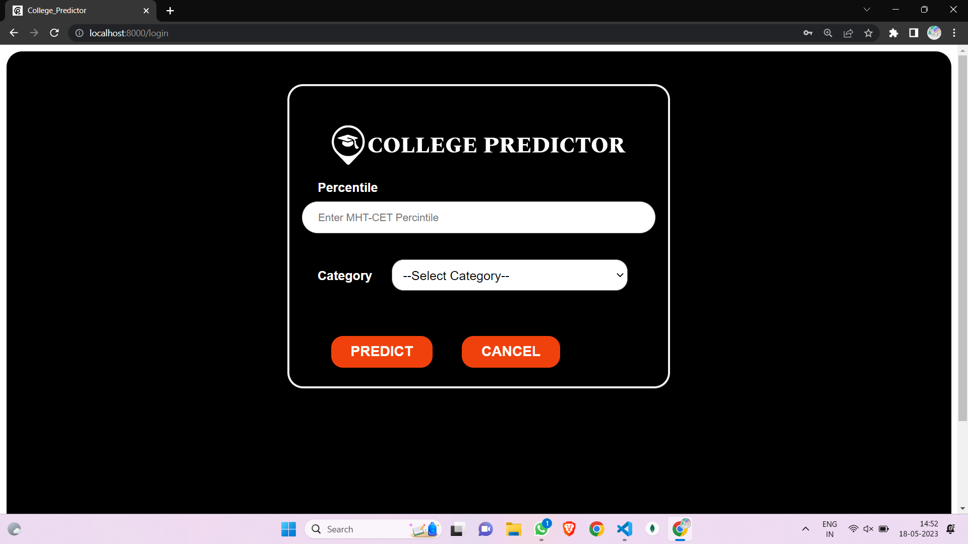
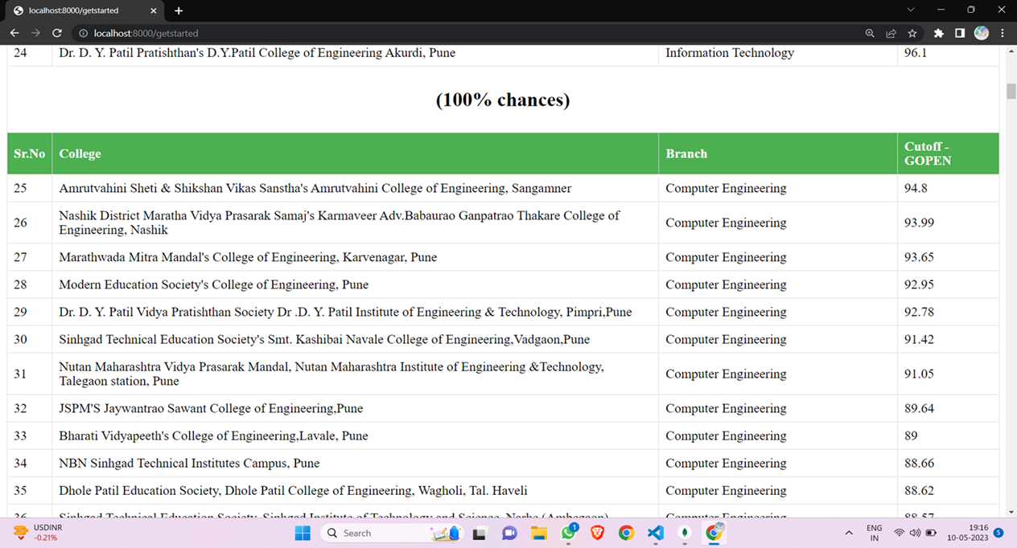
5.2 Implementation
4.Predicted College List:
After clicking on Predict button college list will appear on the webpage according to entered details by student as shown in picture
3. Percentile Page:
It contains two fields percentile and category.
Student have to fill respective options correctly to predict college.
Project Presentation
11

Slide 12
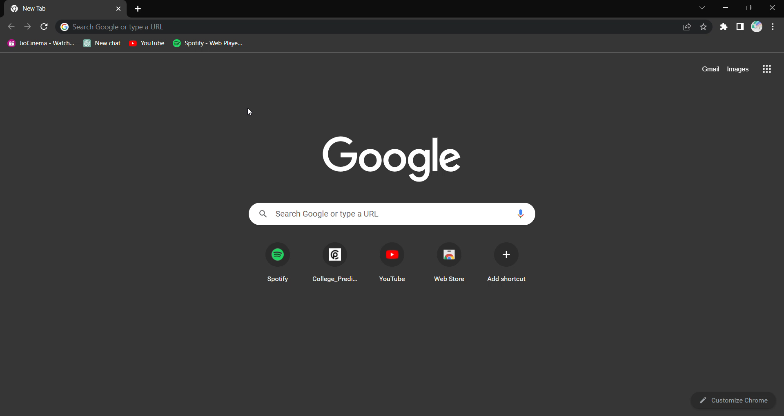
5.3 Implementation
2.Video of Implementation of Project:
Project Presentation
12

Slide 13
6. Conclusion and Future Scope
College prediction project using MHT-CET marks is an important research area that has gained significant attention in recent years. The project involves predicting the college that a student is likely to get admission to based on their MHT-CET marks.
Future Scope:
Future research in college prediction using MHT-CET marks can focus on the following areas:
1. Investigating the impact of additional factors, such as academic performance in high school, extracurricular activities, and personal statement, on college admissions.
2. Integrating the proposed model into a web-based application that can provide personalized recommendations to students based on their MHT-CET marks and other relevant factors.
In conclusion, the college prediction project using MHT-CET marks has significant potential for future research and development, which can ultimately benefit students in making informed decisions about their college admissions.
Project Presentation
13

Slide 14
. References
W3 School “Introduction To The Web Development”. https://www.w3schools.com/
Frontend Languages: HTML, CSS link: https://www.thapatechnical.com/
Backend Languages: Node.js, Express.js link: https://www.thapatechnical.com/
Database: MongoDB: https://www.thapatechnical.com/
College Cutoff Data: https://cetcell.mahacet.org/, https://www.shiksha.com/
Project Presentation
14

Slide 15

Thank You !!!
Project Presentation
15

